Slide 1
Entrepreneurship
PRESENTED BY UNNI KRISHNAN V
YATEER CREATIVE SOLUTIONS

Slide 2
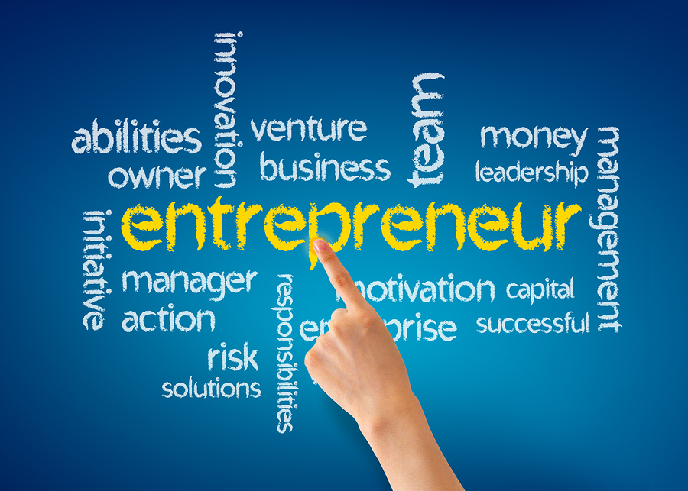

Slide 3
GENERAL DEFINITION
Innovations
Entrepreneur is a person who takes financial risks, involves innovations to generate business ideas, create opportunities to make money, starts profitable businesses, gathers and manages the right resources to reach his goal and mostly is driven by his vision and mission of life.
Finances
Vision,Mission, Goal
Business
Resources

Slide 4
“Entre” means between, the idea of navigating between challenges, between risks and rewards.
“Preneur” means taker, someone who seizes opportunities, someone who takes action
"Preneur" is a French word meaning "taker" or
"one who accepts".
It's often used in combination with other
words, like "entrepreneur," to describe someone who takes action,
seizes opportunities, or is willing to buy.
In the context of business, it can highlight the entrepreneurial spirit
of taking risks and moving forward despite uncertainty.

Slide 5

FINANCIAL RISK

Slide 6
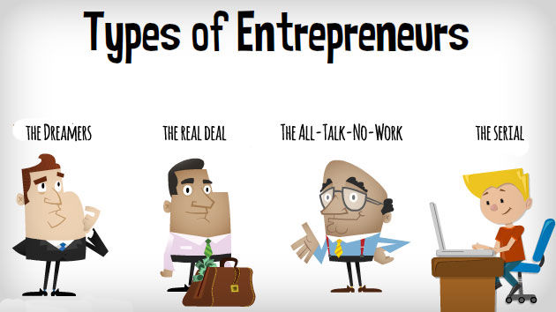
Faith, if it has not works, is dead

Slide 7
What is a lifestyle entrepreneur?
A lifestyle entrepreneur is an individual who creates a business for the purpose of changing their lifestyle instead of focusing on making profits.
A lifestyle entrepreneur focuses more on the rewards of life: Autonomy, Fun, Freedom, Time, Flexibility, Happiness
He is passionate about his works and enjoy what he does

Slide 8
Indian Entrepreneurs Who Overcame Failure
Narayana Murthy (Infosys)
  Struggles: His first venture, Softronics, failed within 1.5 years.
  Success: Co-founded Infosys, now a global IT services giant.
Kalpana Saroj (Kamani Tubes)
  Struggles: Faced child marriage, abuse, and poverty; attempted suicide.
  Success: Revived Kamani Tubes from bankruptcy; awarded Padma Shri.
Hari Menon (BigBasket)
  Struggles: Early e-commerce venture Fabmart failed due to low internet penetration.
  Success: Co-founded BigBasket, India's leading online grocery platform.
Sunil Bharti Mittal (Bharti Airtel)
  Struggles: Initial ventures in bicycle parts and generators faced setbacks.
  Success: Founded Bharti Airtel, one of Asia's largest telecom companies.
Captain G.R. Gopinath (Air Deccan)
  Struggles: Multiple failed ventures including farming and a motorbike dealership.
  Success: Launched Air Deccan, India's first low-cost airline, revolutionizing air travel.

Slide 9
Indian Entrepreneurs Who Overcame Failure
Kiran Mazumdar-Shaw (Biocon)
  Struggles: Faced skepticism as a female entrepreneur in biotechnology.
  Success: Founded Biocon, a leading biopharmaceutical company.
Dheeraj Gupta (JumboKing)
  Struggles: Initial sweet business failed, leaving him in debt.
  Success: Founded JumboKing, a successful vada pav QSR chain.
Ghazal Alagh (Mamaearth)
  Struggles: Faced challenges finding natural products for her child's skin condition.
  Success: Co-founded Mamaearth, a leading toxin-free personal care brand.
Viraj Bahl (Veeba Foods)
  Struggles: Dreamed of participating in MasterChef India; faced initial business challenges.
  Success: Founded Veeba Foods, now a sponsor of MasterChef India and a household name.
Jamsetji Tata (Tata Group)
  Struggles: Denied entry into a European-only hotel during British rule.
  Success: Founded the Taj Mahal Palace Hotel, symbolizing Indian pride and hospitality.

Slide 10
FEW STORIES OF ENTREPRENEURS

Slide 11

Ritesh Agarwal
His hobby was travelling.
He gained valuable insights while traveling and transformed into a business idea.
The need for budget travelling in the nation led to his venture
The company operates in five countries including Singapore,
it is headquartered in Gurugram while having investments from big names like Softbank and Sequoia capital.
With in 1.5 years 32.8 crores
Passion for travel to business idea

Slide 12
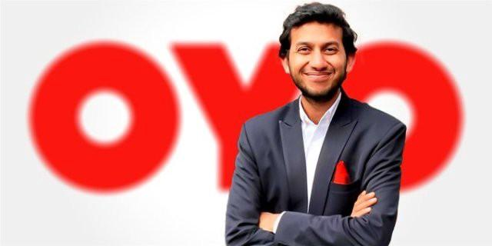
Ritesh Agarwal (born 16 November 1993) is an Indian entrepreneur and the Founder and CEO of OYO Rooms. He is known as the second youngest billionaire in 2021 in India.
His net worth in 2021 was estimated to be approximately $1.1 billion (₹8751 crore) according to Hurun Rich List 2020. As of February 2020, he is the second youngest self-made billionaire in the world after Kylie Jenner

Slide 13
LET’S PLAY SOME BRAIN GAMES

Slide 14


13 + 6 =
4 + 55 =
87 + 2 =
12 + 52 =
75 + 26 =
25 + 52 =
63 + 32 =
123 + 5 =

Slide 15

MONDAY
TUESDAY
WEDNESDAY
THURSDAY
FRIDAY
SATURDAY
SUNDAY
FRIDAY
__________
__________
__________
__________
__________
__________

Slide 16
MONDAY
TUESDAY
WEDNESDAY
THURSDAY
FRIDAY
SATURDAY
SUNDAY
FRIDAY
MONDAY
SATURDAY
SUNDAY
THURSDAY
TUESDAY
WEDNESDAY

Slide 17

COLOUR

Slide 18
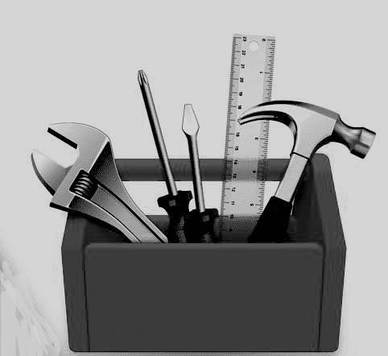
TOOL

Slide 20

HOW MANY OF YOU DID THINK OF THE
COLOUR : RED / BLACK / BLUE / PINK
TOOL: HAMMER / SCREW DRIVER / SCALE/ CHIZZLE

Slide 21
PERSPECTIVE

Slide 22

Alan Mulally
(Boeing → Ford turnaround)

Slide 23
If I can manage airplanes with millions of parts that must stay in the air safely, managing cars with thousands of parts that stay on the ground is manageable.

Slide 24
THIS IS HOW ENTREPRENEUR
THINKS / ANALYZE

Slide 25
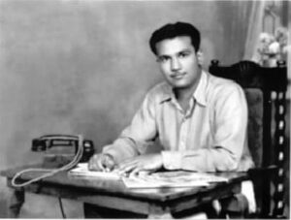

The man behind the ‘Sachet Revolution‘ was not from a multinational company but an Indian himself. Late Chinni Krishnan, based in Cuddalore, Tamil Nadu, was the man who introduced the sachet concept to the Indian market. It was only later on that the sachet concept was picked up by other leading multinational brands.
The brother’s started the Velvet International shampoo product which came in a sachet of Rs 2. Velvet International, eventually expanded not only in India, but overseas as well, and did phenomenally well.

Slide 26
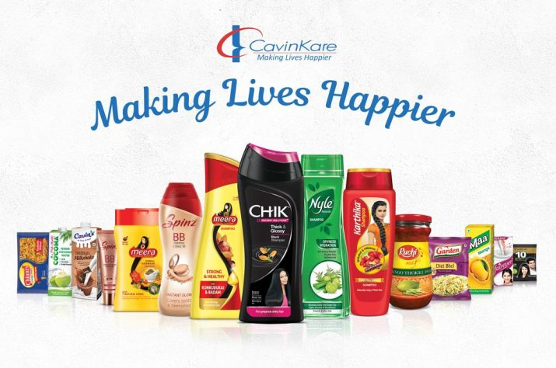
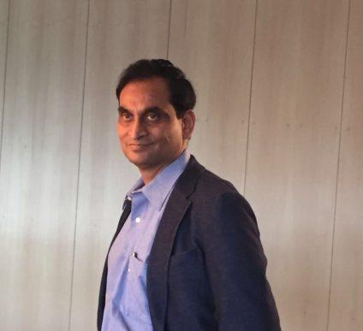
C K Ranganathan
CavinKare

Slide 27
ENTREPRENEURS ARE CONTRIBUTORS TO THE SOCIETY THAN CONSUMERS

Slide 28
JOURNEY

Slide 29
LIFE STYLE

Slide 30
MINDSET

Slide 31
ATTITUDE

Slide 32
VISION / PASSION/ DETERMINATION

Slide 33
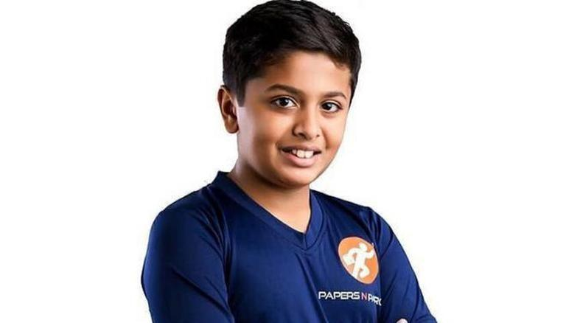
Age 16
PAPERS N PARCELS
Tilak believes that “every ordinary youngster those who are curious enough to know why? when? and what? About anything can become an entrepreneur.
Tilak Mehta Age
Papers N Parcels is a company that offers door-to-door pickup and delivery services for about everything, starting from a pen to all of your important paperwork.
On a daily basis, it delivers roughly 1200 parcels to their destinations on the same day.

Slide 34
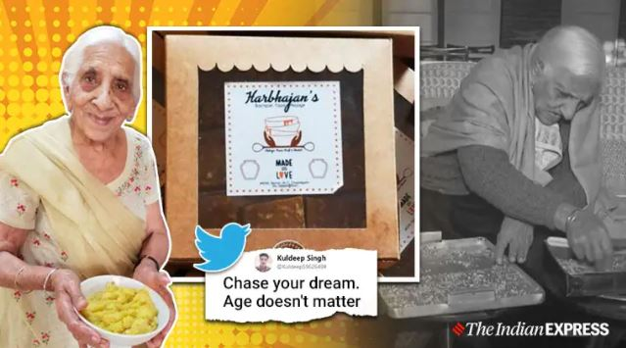
Age 98
HARBHAJANS
Harbhajan Kaur
Suri decided to motivate her then 90-year-old mother to sell her personal favourite “besan ki barfi”.

Slide 35
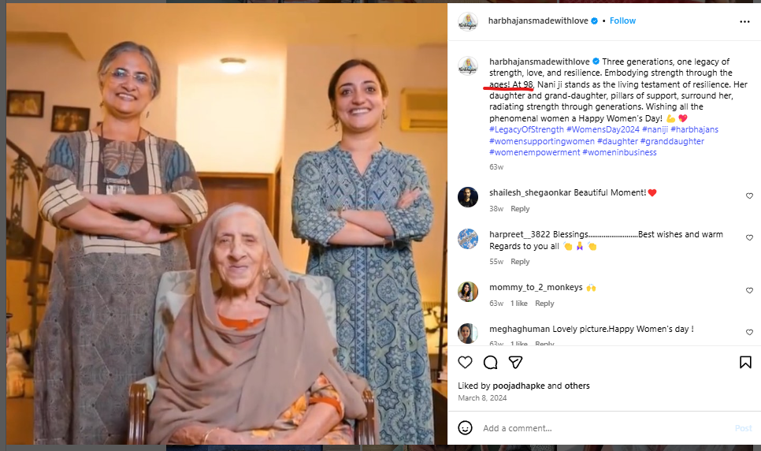
https://www.facebook.com/photo.php?fbid=257086753166925&id=102998835242385&set=a.103073985234870

Slide 36
Maturity Doesn't Come With Age

Slide 37
Difference Between
Businessman / Women
Industrialist
Entrepreneur

Slide 38
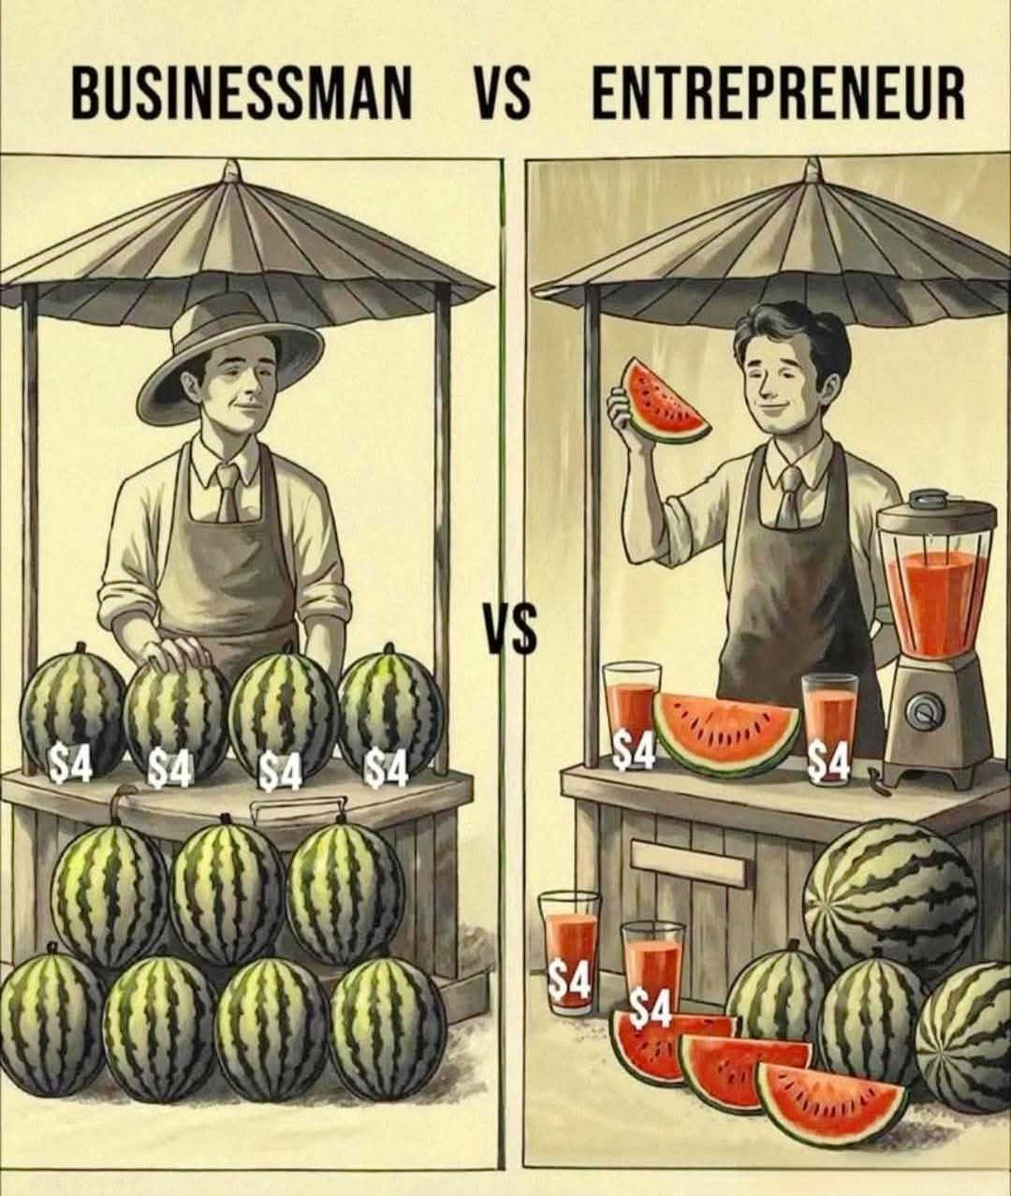

Slide 39
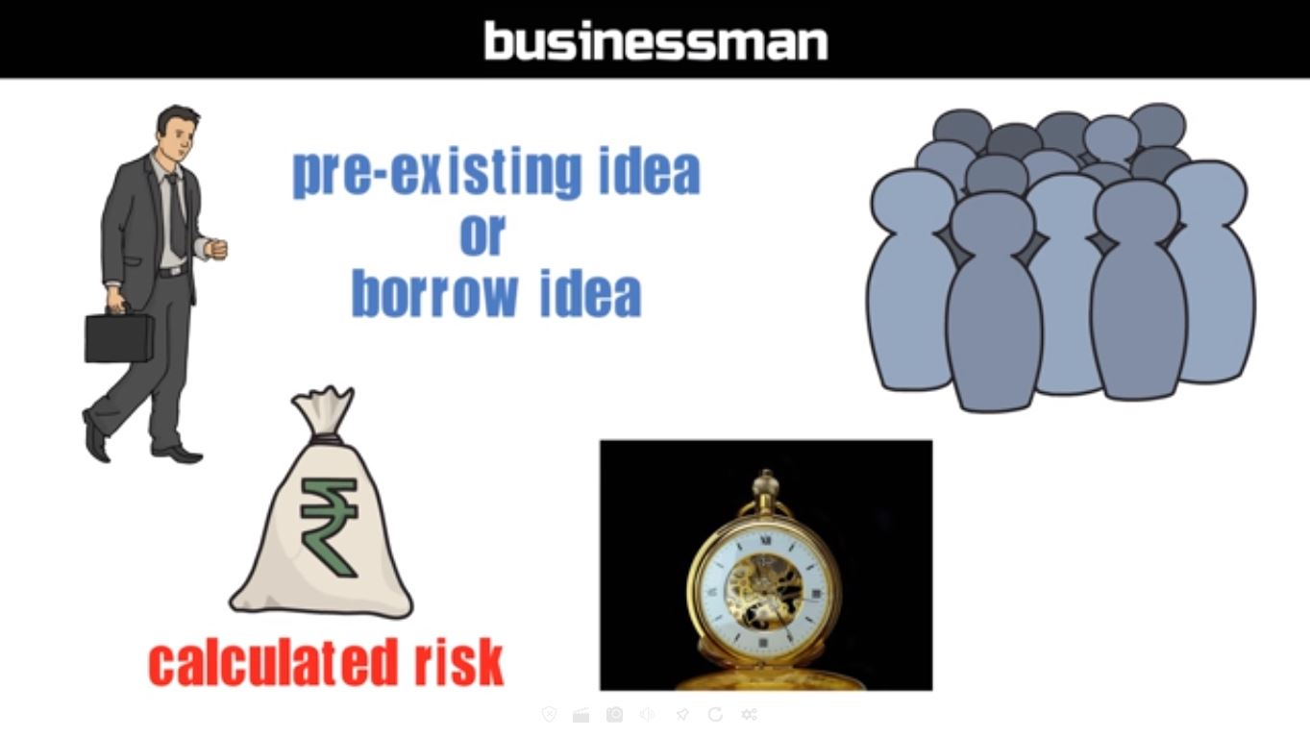

Slide 40
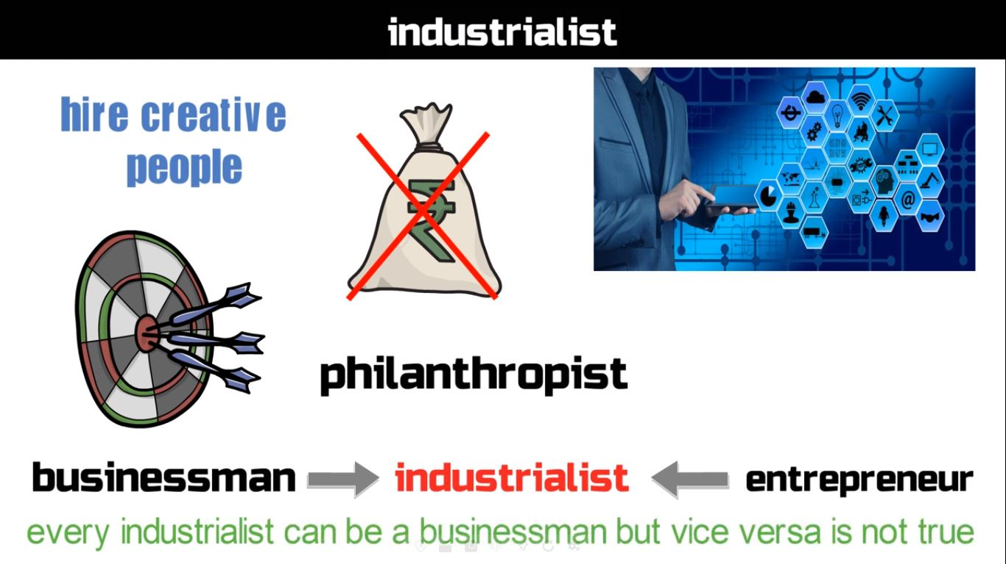

Slide 41
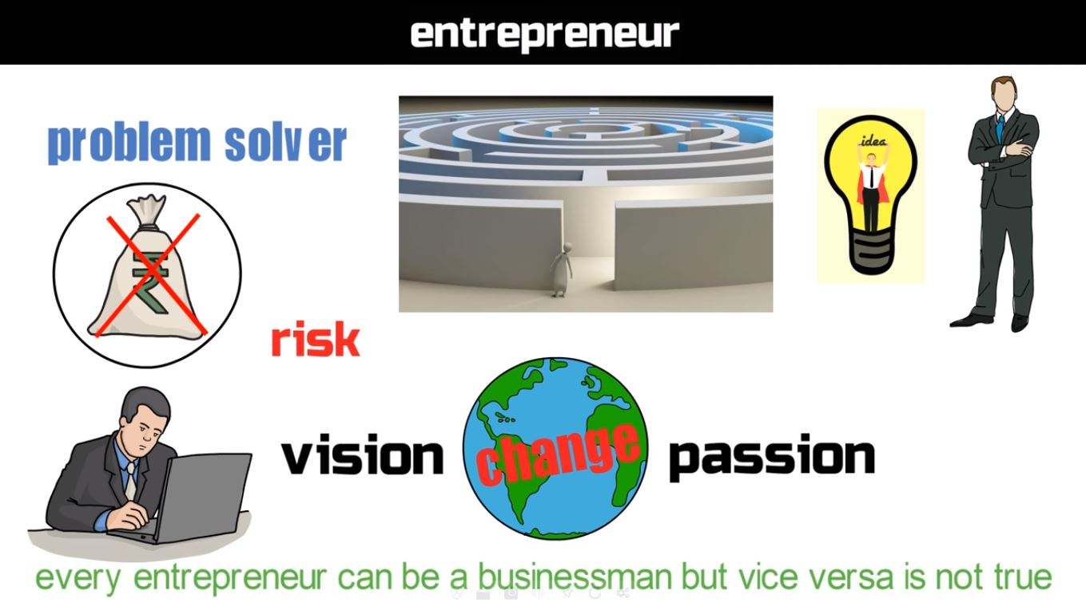

Slide 42
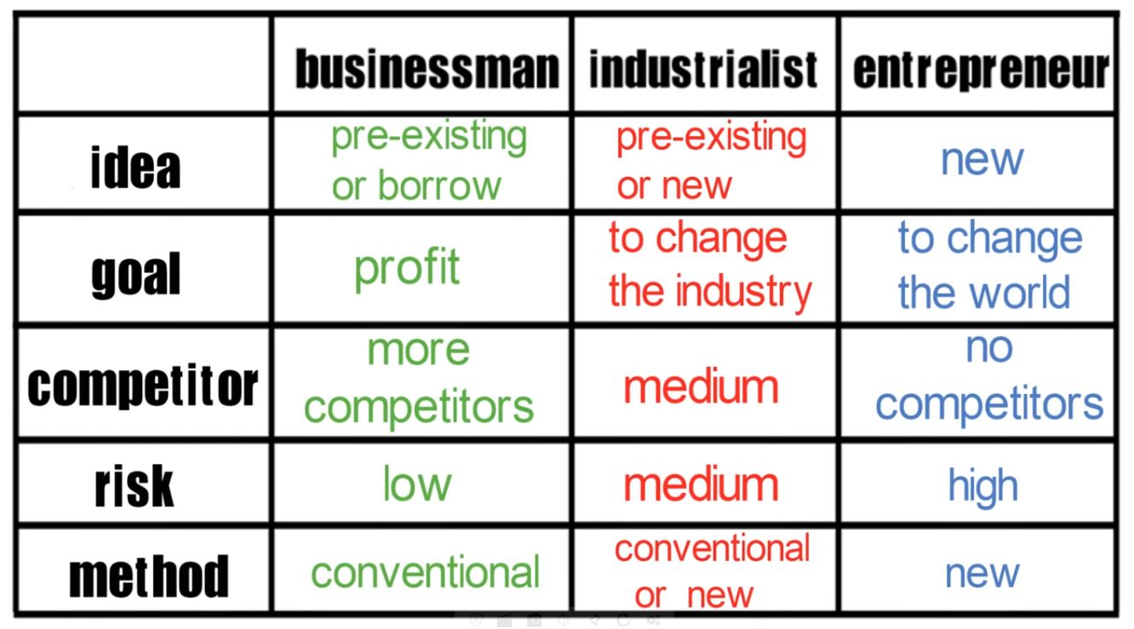

Slide 43
ENTREPRENEURSHIP SKILLS
PROBLEM SOLVING SKILLS - AMUL
CREATIVE THINKING SKILLS - AMUL
DECISION MAKING SKILLS - TATA (JAGUAR)
LEADERSHIP SKILLS - DOMINOS (PATRICK DOYLE)
RISK TAKING SKILLS - DOMINOS
COMMUNICATION SKILLS (SPEAKING AND LISTENING) -
PLANNING SKILLS -
FINANCIAL SKILLS -
TIME MANAGEMENT SKILLS -
MARKETING AND NETWORKING SKILLS - DOMINOS/AMUL

Slide 45
WHY ENTREPRENEURSHIP?
Helps in Wealth creation and sharing: By establishing Business entity, entrepreneurs invest their own resources and attract capital from investors, lenders and the public.
Creating Employment Opportunities jobs: Entrepreneurs are by nature and definition job creators, as opposed to job seekers.

Slide 46
Innovation: Entrepreneurs use businesses to create products and services that solve problems in innovative ways. There products and services must be functional and they must be designed to be cost effective.
Balanced Regional Development: Entrepreneurs setting up new businesses and industrial units help with regional development by locating in less developed and backward areas.

Slide 47
Improves Standards of Living of People: Increase in the standard of living in a community is another key goal of economic development. Entrepreneurs play a key role in increasing the standard of living in a community.
They do this not just by creating jobs, but also by developing and adopting innovation that led to improvement in the quality of life of their employee, customers and other stakeholders in the community.

Slide 48
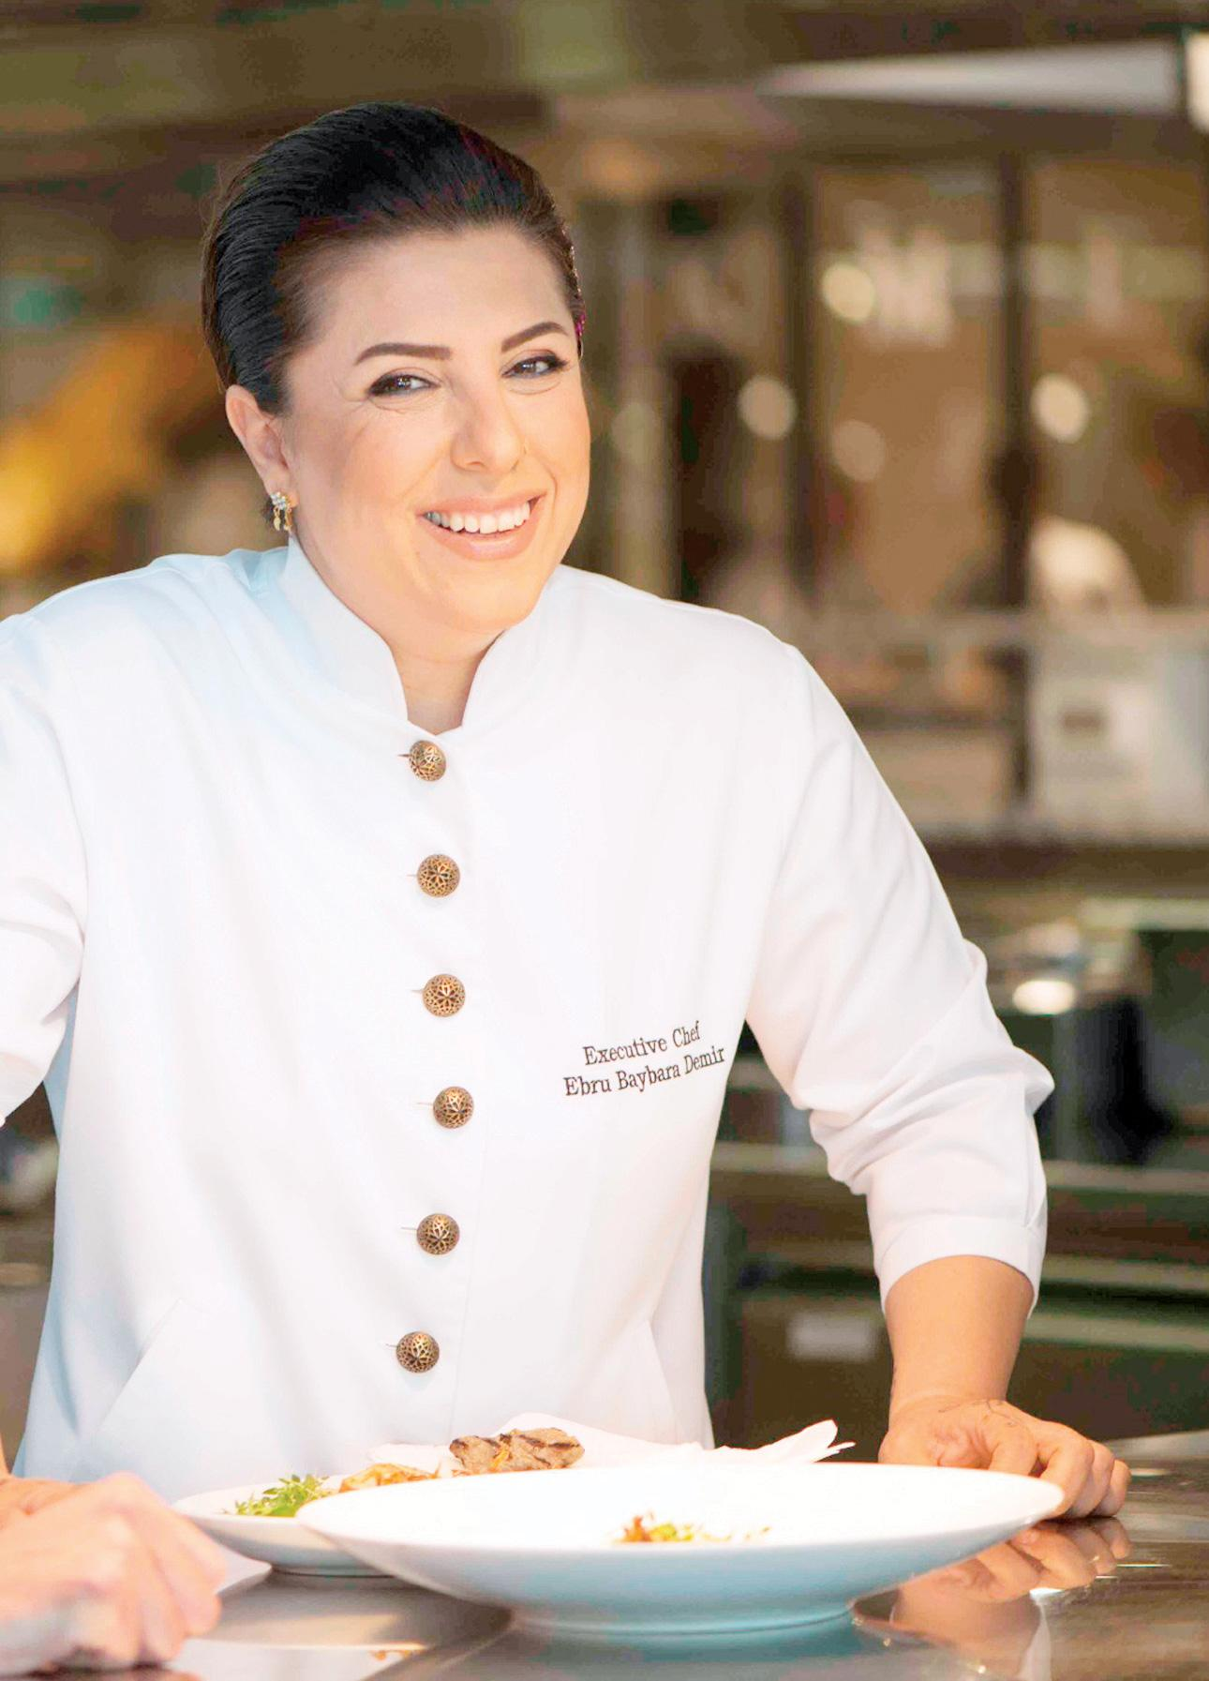
EBRU BAYBARA DEMIR

Slide 49
EBRU BAYBARA DEMIR- A TURKISH CHEF WANTED TO IMPROVE LIVING STANDARDS OF HER CITY
Born in Edirne in a Mardin family in 1976, after completing her studies, she settled in Mardin that has nothing more than a 3-star hotel and a small diner.
But she had a big dream, she was going to introduce tourism to Mardin.
This was a really brave move in a city, where tourism income is so low
Challenges : the terror-related security issues, no agriculture, no trade due to the war in the Middle East, most of the women don’t leave their homes without their husbands.

Slide 50
She had the goal of contributing to the employment of people by using cuisine.
Ebru Baybara Demir and the 21 women with her renovated a historical Assyrian mansion and turned it into a restaurant.
“Cercis Murat Mansion” was born as the first tourism establishment of Mardin, and also as the first and only chef restaurant of the region.
She generates different projects on bringing the food from soil to plate, which opens job opportunity for many people to run those projects.
https://ebrubaybarademir.com/en/home/

Slide 51
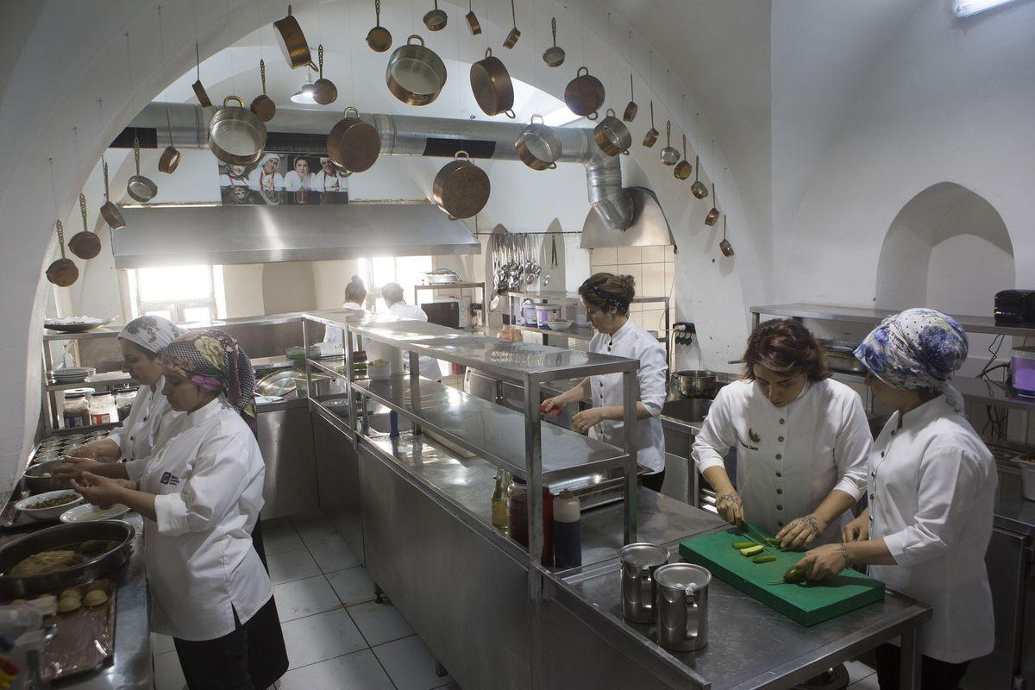

Slide 52
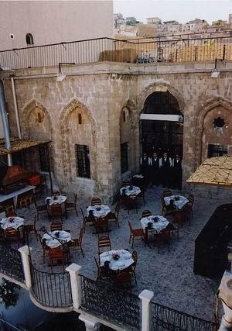


Slide 53
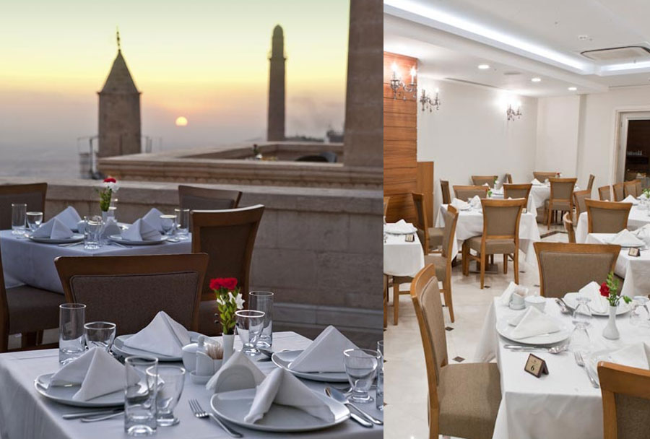

Slide 54
AMAZON.COM'S JEFF BEZOS INNOVATES BY FIRST LISTENING TO HIS CUSTOMERS
When Jeff Bezos first launched Amazon.com 15 years ago, plenty of analysts saw it as a company with little potential for growth. After all, how much money can you really make selling books?
The Kindle, Amazon's electronic reading device, is changing the way we look at reading.
customers are operating their software on Amazon's computer systems, paying only for the computer power they actually use, Amazon is changing the face of information technology.

Slide 55
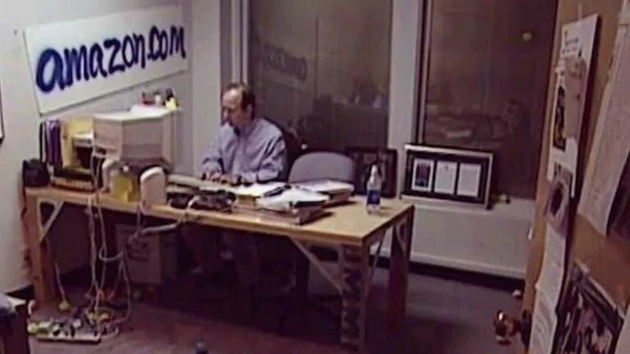

Slide 56
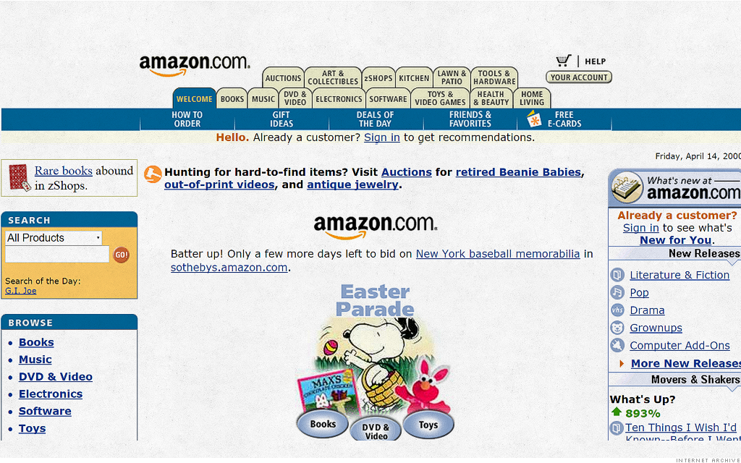
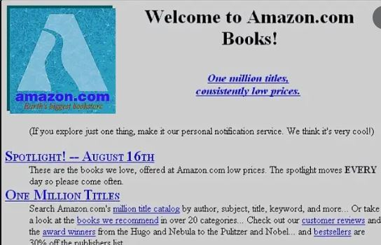

Slide 57
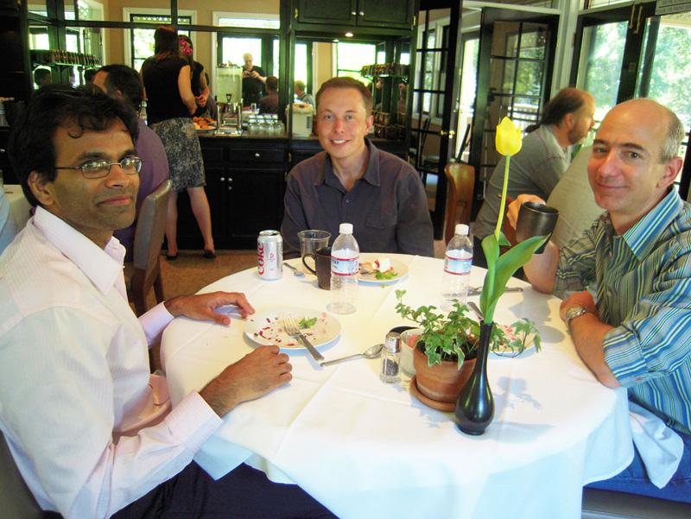

Slide 58
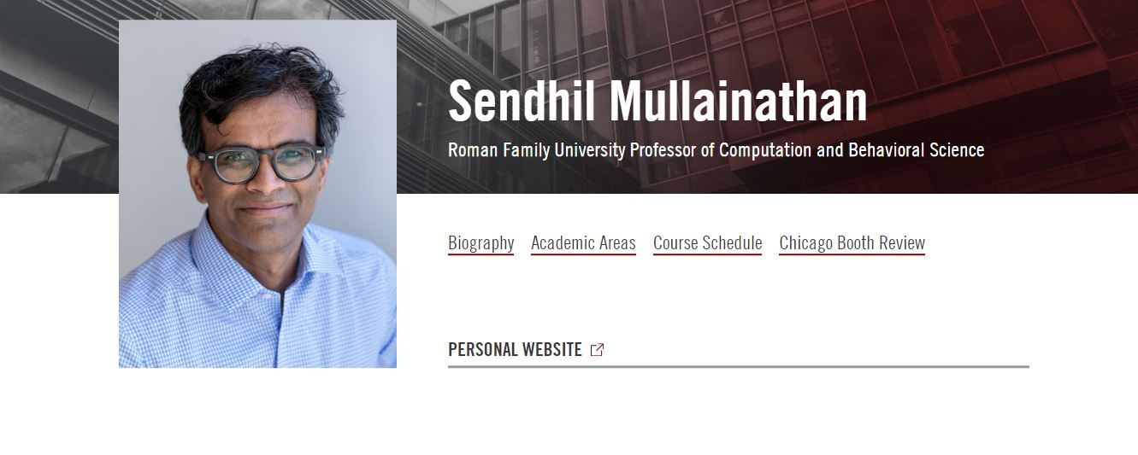

Slide 59
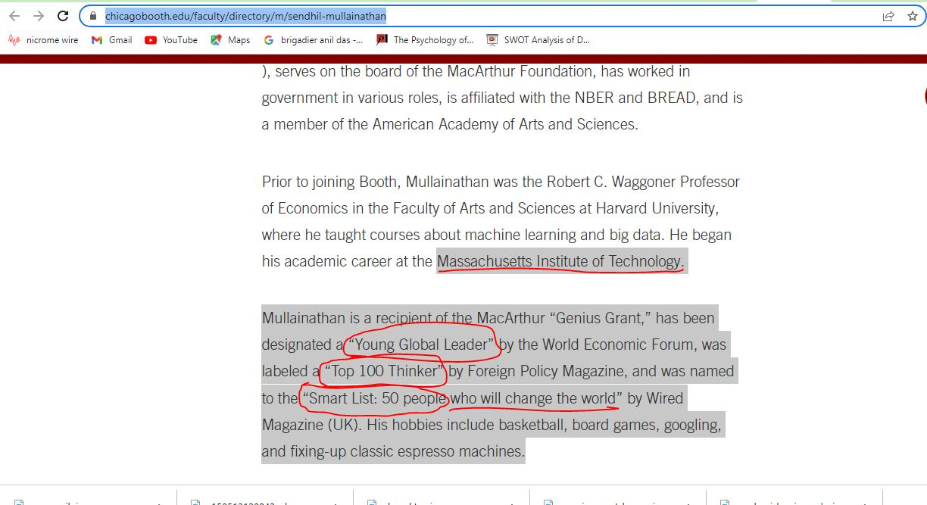

Slide 60
STEPS IN STARTING A NEW BUSINESS VENTURE
Idea: The first step is to come up with a business idea. It could be based on your interest and present market conditions.
Getting money and material: Once you have the idea, you can start on a small scale with some money which will help you in buying basic material.

Slide 61
Understanding customers need: Once you start selling, you will find out what your customer likes and wants. You will also find out what your customer does not like during this stage.
Improving Product/Service: You can use this knowledge of what your customer like and does not like to improve your products and services

Slide 62
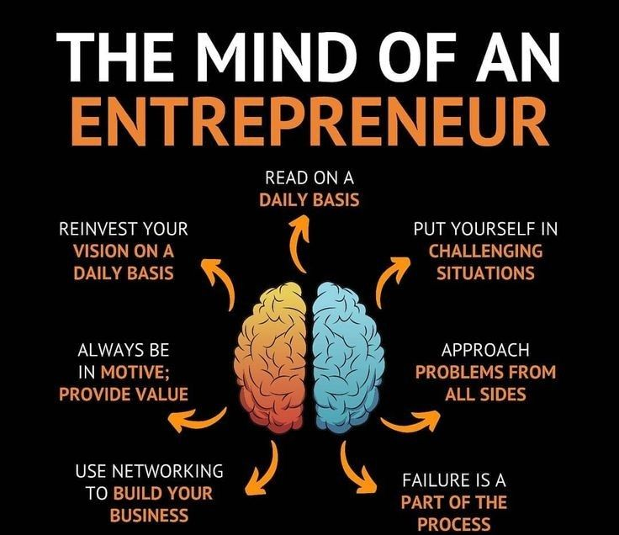

Slide 63
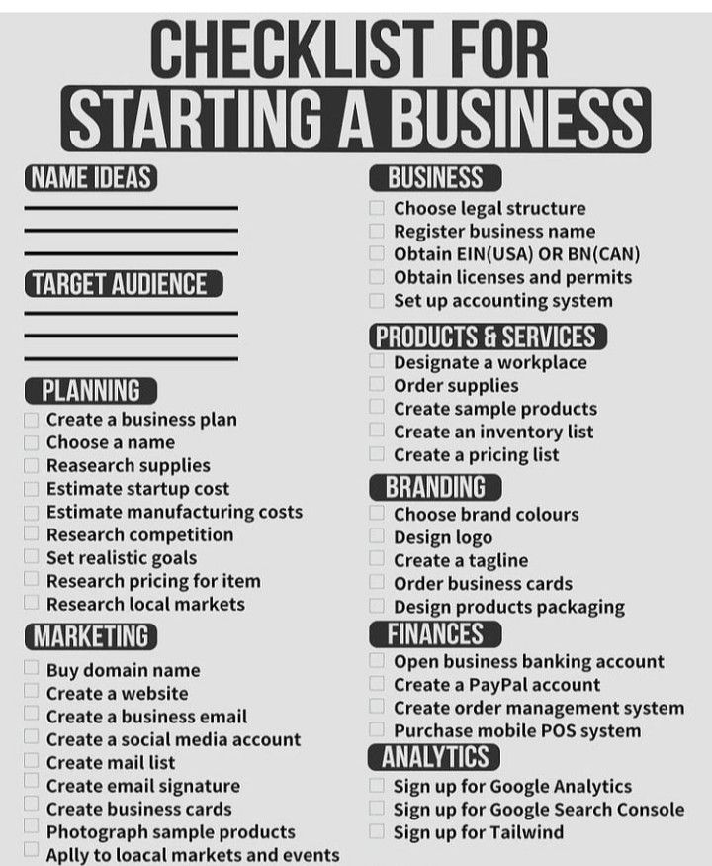

Slide 64
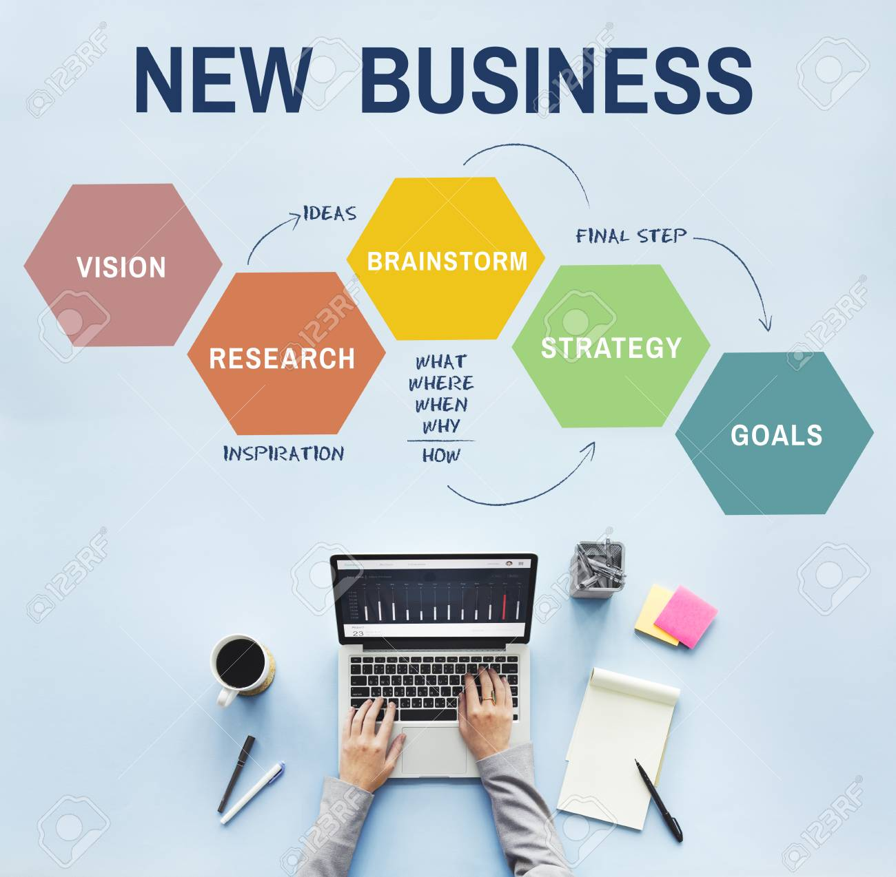

Slide 65
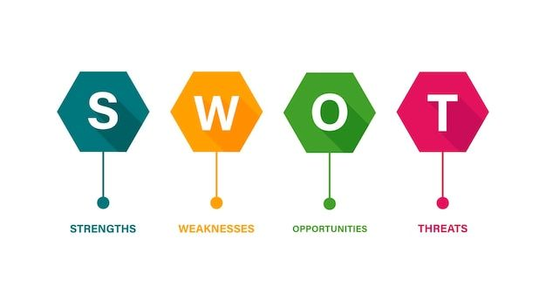

Slide 66
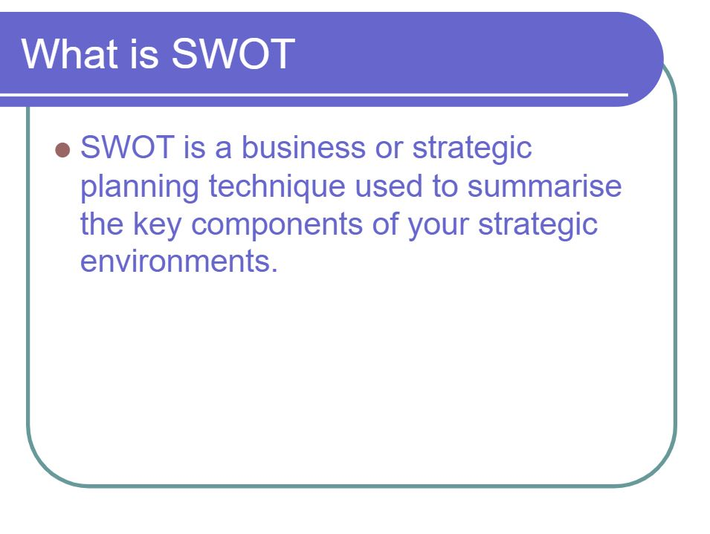
It helps business to build a strategic plan to meet goals, improve operations and keep the business relevant.

Slide 67
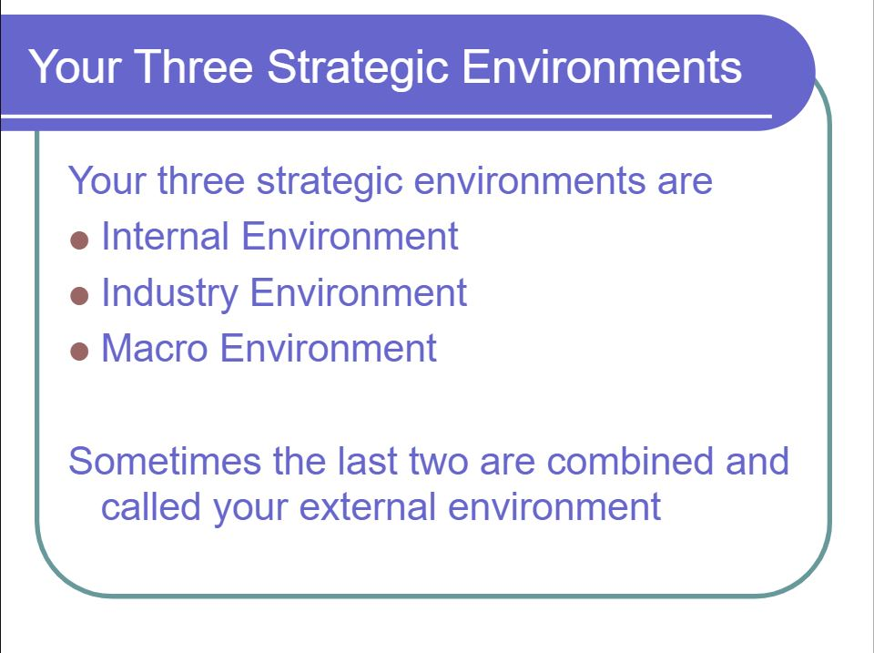

Slide 68
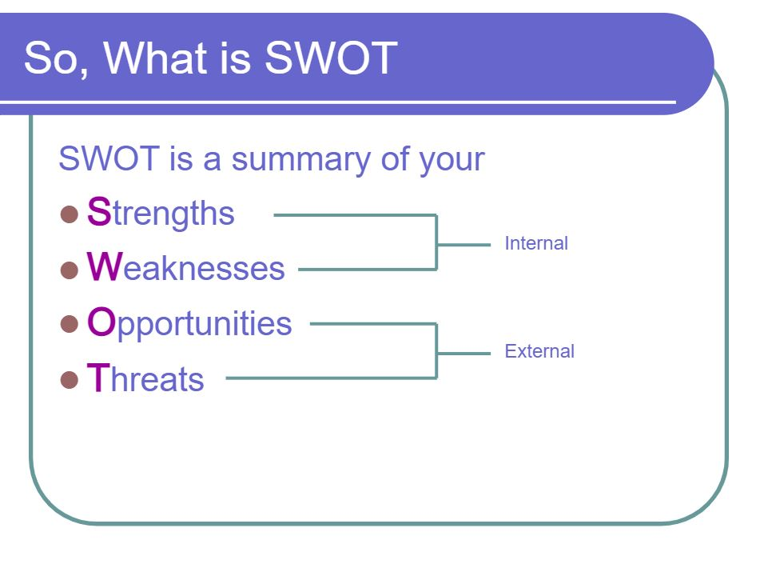

Slide 69
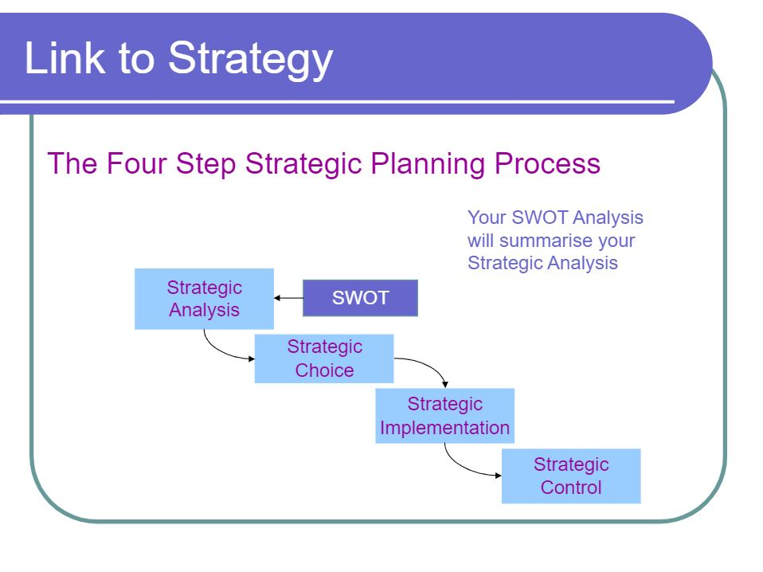
The best strategic fits for products/services/projects for the business are when the internal environment (strengths and weaknesses) aligns with the external environment (opportunities and threats).

Slide 70
WHEN TO CONDUCT A SWOT ANALYSIS
SWOT can be used to explore new ventures, products, acquisitions or mergers.
It can help businesses change course mid-project, plan out how to invest money, understand competitors and to identify the brand’s mission.
SWOT can also help non-profit companies and government agencies manage or allocate grants, donations and funding.
It can be applied to a range of business situations relating to everything from IT to marketing to operations.

Slide 71
AN EXERCISE FOR YOU TO PLAN FOR YOUR BUSINESS TO START
Write Down the SWOT Matrix for your Start-Up Business and make a plan of action and a plan of marketing, Keeping the following points in mind:
What business do you want to start?
What is the objective(goals/purpose) of the business?
What do you want to sell?
How Many People Do you Need?
What do you want to achieve through your start-up business in next 3 months?
What do you have in your hand to start?
What do you need to start that you do not have?

Slide 72
HELPGUIDE
WEAKNESSES
STRENGTHS
Do you have a unique idea / product to sell?
Do you know first few people to sell your product/idea?
Do you know what price should you sell your product?
Have you marketed your product?
Do you need a team to start your business?
Do you know how to deliver your products?
Do you know how to package your products?
Do you have budget to deliver your product?
THREATS
OPPORTUNITIES
Who are your competitors?
Could you sell your product irrespective of pandemic?
What external factors could reduce /stop your sales?
Is your price competitive enough?
Can you identify people who are not yet reached with product like yours?
Is there upcoming events to promote your product?
What are the current trends that you can leverage?

Slide 73
SELF-HELP SWOT Analysis for Personal Life (Example)
WEAKNESSES
STRENGTHS
Self-Awareness
You recognize your emotions, patterns, and needs.
Resilience
Able to bounce back from setbacks and adapt to change.
Willingness to Improve
Actively seeking personal growth, knowledge, and mental clarity.
Supportive Relationships
Have friends/family who encourage and support your goals.
Time Management Skills
Capable of prioritizing tasks and creating structure when needed.
Procrastination
Delay in taking action despite knowing the importance of certain tasks.
Inconsistent Routines
Struggle with maintaining daily healthy habits (e.g., sleep, exercise, journaling).
Overthinking or Self-Doubt
Tendency to overanalyze, leading to mental fatigue and missed opportunities.
Difficulty Saying “No”
May take on too much, affecting boundaries and self-care.
Fear of Judgment or Failure
Sometimes prevents you from fully expressing or investing in your potential.
OPPORTUNITIES
THREATS
Building a Growth Mindset
Embrace failures as lessons and stay open to new experiences.
Learning New Skills
Time to learn practical or creative skills that support career and personal development (e.g., cooking, mindfulness, financial literacy).
Joining Supportive Communities
Being part of groups that align with your goals (fitness clubs, reading circles, entrepreneur meetups, etc.).
Therapy or Coaching
Seeking professional support for emotional clarity and direction.
Establishing Morning/Evening Rituals
Small habit stacking can lead to major life transformations.
Burnout or Chronic Stress
Neglecting rest and self-care could lead to exhaustion or emotional imbalance.
Toxic Relationships
Being surrounded by negative or unsupportive people can drain your energy and confidence.
Information Overload
Consuming too much social media or self-help content without applying it can lead to confusion and comparison.
Unrealistic Expectations
Expecting fast results without appreciating the small wins along the way.
Health Neglect
Ignoring physical/mental wellness signs due to a busy lifestyle or avoidance.

Slide 74
Home-Based Pastry Business – SWOT (with personal life balance focus)
STRENGTHS
WEAKNESSES
Low Start-up Cost
Operate from home with minimal equipment and space.
Flexible Working Hours
Better balance between personal and professional life.
Custom Orders & Personal Touch
Builds strong customer loyalty, especially in local neighborhoods.
Direct-to-Customer Sales
No middlemen; higher profit margins.
Scope for Experimentation
Freedom to test and introduce new products based on customer feedback.
Limited Production Capacity
Challenging to handle large orders alone, especially during festivals or events.
Work-Life Overlap
Blurred boundaries between home and work may lead to burnout.
Lack of Formal Branding
May struggle to build a strong brand or compete with established bakeries.
Marketing Limitations
Relying mostly on word of mouth or social media; limited reach without budget.
Regulatory Hurdles
Need FSSAI licenses, home kitchen hygiene standards, etc.
OPPORTUNITIES
THREATS
.Niche Offerings
Vegan, gluten-free, eggless, healthy pastries – cater to special dietary markets.
.Festival & Celebration Orders
Seasonal spikes for Rakhi, Diwali, Christmas, birthdays, etc.
.Workshops & Online Baking Classes
Add revenue by teaching baking from home or online.
.Social Media Marketing
Instagram & WhatsApp groups can drive sales and grow loyal customer base.
.Corporate Gifting
Small batch personalized gift boxes for local businesses.
.Burnout & Time Pressure
Personal life may suffer during bulk orders or festivals.
.Dependence on One Person
If you're ill or unavailable, the entire business halts.
.Delivery/Logistics Challenges
Managing timely and safe delivery from a home base can be difficult.
.Price Sensitivity
Customers may compare with larger bakeries and expect lower pricing.
.Copycats
Easy for others to replicate your products or pricing strategy.

Slide 75
Premium Pastry Café – SWOT (with personal life implications)
STRENGTHS
WEAKNESSES
Strong Brand Building Potential
High-end presentation, ambiance, and product quality create customer recall.
Dine-In Experience
Adds value beyond the product, justifying premium pricing.
High Profit Margins on Premium Products
Designer pastries, custom desserts, and beverages offer better margins.
Instagrammable Environment
Drives organic social media marketing and influencer collaborations.
Multiple Revenue Streams
Dining, takeaway, online orders, catering, and event hosting.
High Initial Investment
Rent, interiors, staff, equipment – large upfront capital needed.
Long Working Hours
Daily operations demand full-time commitment; less personal time.
Dependence on Location
Walk-ins depend on visibility, footfall, and surrounding businesses.
Staffing & Training
Skilled pastry chefs and trained front-end staff are hard to find and retain.
Fixed Costs
High monthly operational expenses (rent, utilities, salaries).
OPPORTUNITIES
THREATS
Luxury Gifting & Event Tie-Ups
Weddings, corporate events, festivals – premium demand.
Menu Expansion
Add coffee, desserts, breakfast – increase footfall and order value.
Brand Extensions
Launch merchandise, baking classes, recipe books, frozen product lines.
Loyalty Programs & Subscriptions
Reward repeat customers, create consistent monthly income.
Franchising or Pop-ups
Expand to new areas via cloud kitchens or franchise models.
Work-Life Imbalance
Managing a café is time-intensive and emotionally taxing.
Economic Slowdowns
Luxury food is a discretionary spend – easily affected by inflation or downturns.
Changing Trends
Constant need to innovate or risk becoming outdated.
Food Safety and Legal Compliance
Any mishap can damage reputation or lead to legal penalties.

Slide 76
OTHER SWOT ANALYSIS THAT YOU COULD DO
SWOT Analysis on your competitors: Will help you make strategies on how to position themselves against competitors
SWOT Analysis on your product: Will help you make strategies on how to position your product in the market
SWOT Analysis on your team: Will help you make strategies on how to hire people in your team

Slide 77
IF YOU ARE A CHEF, DON'T START A RESTAURANT WITHOUT A HELP
Focus on and enjoy what you deliver the best, and build up a team who could do their jobs best.
Partnering with people who are best at finance management and / or people management benefits the new venture to run longer miles and enable the Chef to achieve his goals.
Example: Whitecaps Co Founders- They complement each other in running their business and achieving their dreams.

Slide 78
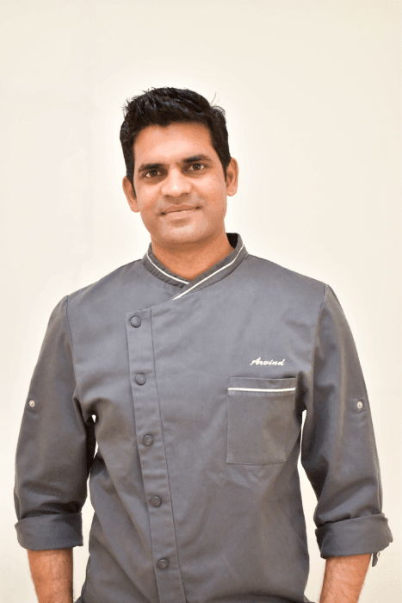
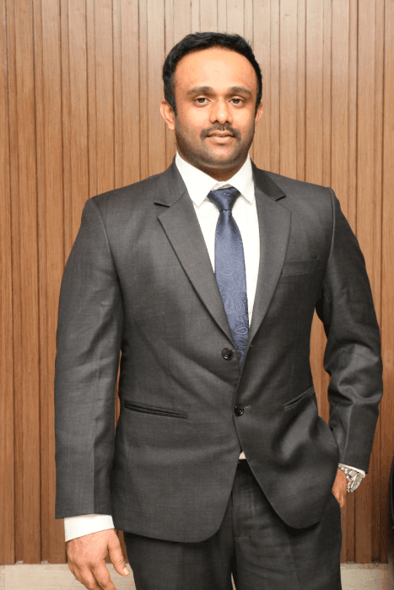
Ved Believes- “One has to only dream and then start to work towards that dream. Don’t stop for what the world believes unless, it is what you believe too.”
Chef Arvind
Vedkiran KR

Slide 79
THEY STARTED WITH A MISSION
Establishment of an International Pastry School in India with a mission to impart the same level of skills and knowledge in culinary as is found in some of the best International Culinary Schools, and to establish an umbrella brand that offers world-class products across varied categories to the Indian palette.
Ever since its inception in 2016

Slide 80
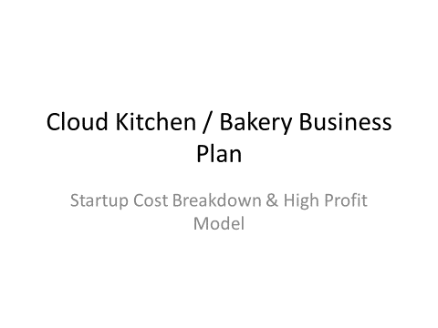

Slide 81
STARTUP COST BREAKDOWN (FOOD BUSINESS)
Low Budget Setup (Home / Cloud Kitchen Model)
Ideal for: Swiggy/Zomato-only kitchens, small baking units
Cost Head | Approx Cost (₹)
Space (Home / Shared Kitchen) | 0 – 10,000
Basic Equipment | 10,000 – 50,000
Raw Ingredients | 5,000 – 15,000
Packaging | 5,000 – 10,000
Marketing (Online Ads, Listings) | 5,000 – 20,000
Licenses & Registration | 2,000 – 10,000
Miscellaneous | 5,000 – 10,000
Total (Low Range): ₹30,000 – ₹1,00,000

Slide 82
Mid-Level Setup
(Small Bakery / Café / Cloud Kitchen with Staff)
Cost Head | Approx Cost (₹)
Rent Deposit + Interiors | 50,000 – 2,00,000
Equipment (Ovens, Mixers, Fridge) | 1,00,000 – 4,00,000
Ingredients | 20,000 – 50,000
Packaging | 10,000 – 30,000
Branding + Marketing | 20,000 – 1,00,000
Licenses | 5,000 – 20,000
Staff Setup | 30,000 – 1,00,000
Total: ₹2 Lakhs – ₹8 Lakhs

Slide 83
Premium Café / Branded Bakery Setup
Cost Head | Approx Cost (₹)
Interiors + Ambience | 3 – 10 Lakhs
Equipment | 5 – 15 Lakhs
Rent Deposit | 2 – 5 Lakhs
Staff + Operations | 1 – 3 Lakhs
Branding + Launch Marketing | 1 – 3 Lakhs
Licenses | 20,000 – 50,000
Total: ₹10 Lakhs – ₹30+ Lakhs

Slide 84
FSSAI LICENSE COST (OFFICIAL STRUCTURE)
About Food Safety and Standards Authority of India
License Types & Fees
License Type | Eligibility | Fee (₹/Year)
Basic Registration | Turnover < ₹12 Lakhs | ₹100
State License | ₹12 Lakhs – ₹20 Crore | ₹2,000 – ₹5,000
Central License | > ₹20 Crore | ₹7,500
Additional Costs (Realistic)
Item | Cost (₹)
Documentation + Consultant | 2,000 – 10,000
Renewal (1–5 years) | Same as license
Modification Fees | ₹1,000+

Slide 85
OTHER REQUIRED LICENSES (IMPORTANT)
these are mandatory:
License | Cost (₹)
FSSAI | 100 – 7,500
GST Registration | Free
Shop & Establishment | 1,000 – 5,000
Fire License | 5,000 – 50,000
Municipal / BBMP Trade License | 5,000 – 25,000

Slide 86
REALISTIC TOTAL STARTUP SUMMARY
Business Type | Total Cost
Home Cloud Kitchen | ₹30K – ₹1L
Small Bakery / Kitchen | ₹2L – ₹8L
Premium Café | ₹10L – ₹30L+
IMPORTANT INSIGHTS (VERY PRACTICAL)
Biggest cost = Equipment + Rent
Most beginners fail due to:
  Overspending on interiors
  Poor marketing
  Wrong menu pricing
Cloud kitchen is lowest risk entry point
FSSAI is mandatory even for home kitchen

Slide 87
Business Model
(High Profit Structure)
Concept:
👉 Focus:
Cakes (eggless, high demand)
Snacks (quick selling items)
Combos (increase order value)
👉 Platforms:
Swiggy + Zomato
Instagram + WhatsApp direct orders
👉 Target:
Office crowd
Students
Birthday/celebrations

Slide 88
Revenue Model
₹50,000 PROFIT MODEL (CLEAR NUMBERS)
🔹 Daily Sales Target
20 Orders per Day
Average Order Value: ₹250
Daily Revenue: ₹5,000
Monthly Revenue: ₹1,50,000
Expense | Monthly (₹)
Raw materials | 40,000
Packaging | 10,000
Rent (shared / home) | 10,000
Swiggy/Zomato commission (~25%) | 30,000
Electricity + Gas | 5,000
Marketing | 5,000
✅ FINAL PROFIT
👉 ₹1,50,000 – ₹1,00,000 =
₹50,000 PROFIT / MONTH
🔹 Expense Breakdown
👉 Total Expenses = ₹1,00,000

Slide 89
EXACT EQUIPMENT LIST (WITH REALISTIC PRICES)
🔹 Baking + Kitchen Setup
Equipment | Approx Price (₹) | Notes
OTG Oven (60L) | 10,000 – 15,000 | Start small
Planetary Mixer (5L) | 8,000 – 15,000 | Essential
Refrigerator | 12,000 – 20,000 | Storage
Induction Cooktop | 2,000 – 5,000 | Backup cooking
Cake Moulds & Tools | 3,000 – 8,000 | One-time
Weighing Scale | 500 – 1,500 | Accuracy
Work Table | 5,000 – 10,000 | Stainless steel
4
👉 Total Equipment Cost: ₹40K – ₹80K
Packaging Setup
Item Cost (₹)
Cake boxes 2,000
Food containers 3,000
Stickers / branding 2,000
4
👉 Total Equipment Cost: ₹5K – ₹10K

Slide 90
HIGH PROFIT MENU (ENGINEERED)
Cakes (Highest Margin ~60%)
Item | Cost | Selling Price | Profit
Chocolate Cake (500g) | ₹150 | ₹399 | ₹250
Red Velvet | ₹180 | ₹449 | ₹270
Butterscotch | ₹140 | ₹349 | ₹200
Fast Moving Snacks (~50% Margin)
Item | Cost | Price | Profit
Veg Sandwich | ₹30 | ₹120 | ₹90
Cheese Maggi | ₹40 | ₹140 | ₹100
Paneer Roll | ₹50 | ₹150 | ₹100
Loaded Fries | ₹60 | ₹180 | ₹120
Combo Strategy (MOST IMPORTANT 🔥)
Combo | Price
Cake Slice + Coffee | ₹199
Sandwich + Fries + Drink | ₹249
Birthday Mini Combo | ₹499
Cakes (60% Margin)
Snacks (50% Margin)
Combos to increase order value
Focus on fast-moving items

Slide 91
PRICING STRATEGY (CRITICAL) Use this rule:
Food Cost = 30–40%
Selling Price = 2.5x to 3x cost
👉 Example:
Cost = ₹100 → Sell at ₹250–₹300
MARKETING SYSTEM (FREE + PAID)
🔹 Organic (FREE)
Instagram reels daily (cakes, making videos)
Google My Business listing
WhatsApp broadcast
🔹 Paid
Swiggy/Zomato ads → ₹200/day
Instagram ads → ₹100/day
DAILY OPERATIONS PLAN
Time | Task
Morning | Prep + baking
Afternoon | Listing optimization
Evening | Peak orders
Night | Social media posting

Slide 92
COMMON MISTAKES (AVOID THIS)
❌ Too many menu items
❌ Expensive interiors
❌ Ignoring online reviews
❌ Low-quality photos
SUGGESTIONS
Start with 10-item menu only (fast execution)
Focus on 1 signature cake (viral product)
Use dark kitchen model → lowest cost
Invest in food photography (huge ROI)
Offer ₹50 discount first order (conversion boost)
FINAL STRATEGY SUMMARY
👉 Start small → Focus on high-margin items
👉 Push combos → Increase order value
👉 Use Swiggy/Zomato → Scale fast
👉 Build Instagram brand → Free sales
SCALE PLAN (AFTER 2–3 MONTHS)
Add custom cakes (₹1000+ orders)
Tie-up with offices
Launch subscription meals/snacks
Start second cloud kitchen

Slide 93
